Slide 1
Example Clutter Models
7-17-2018

Slide 2
Disclaimer
The following example clutter models are NTIA proposals that have not been agreed upon within the government.
The example models are meant to provide ideas for an initial structure.
Example Models:
Modified ITU-R P.2180-0
Log Distance Based → Addressing Troposcatter
Log Distance and Antenna Height Based --> Addressing Troposcatter and Transmitters “within” clutter

Slide 3
Modified ITU-R P.2108 (Clutter)
Antenna Height
Drocella Model 3.0

Slide 4
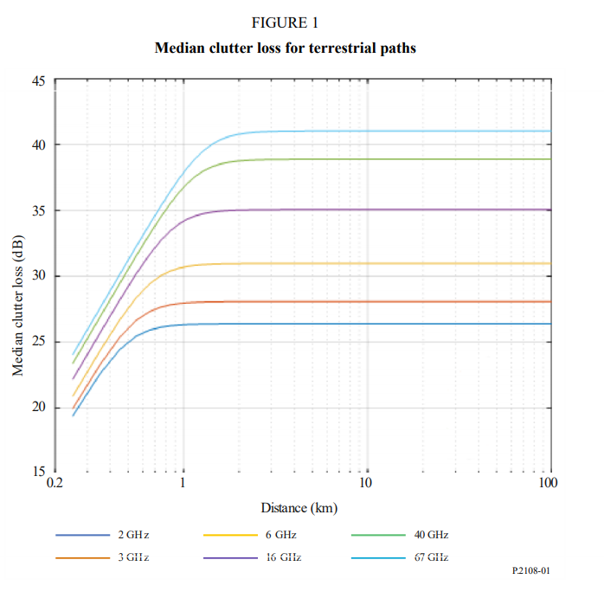
ITU-R P.2108-0
Model #2: Terrestrial terminal within the clutter
At 3.5GHz and at a distance greater than 1km, mean clutter loss is 28dB.
Clutter is randomized with a normal distribution around the mean.

Slide 5
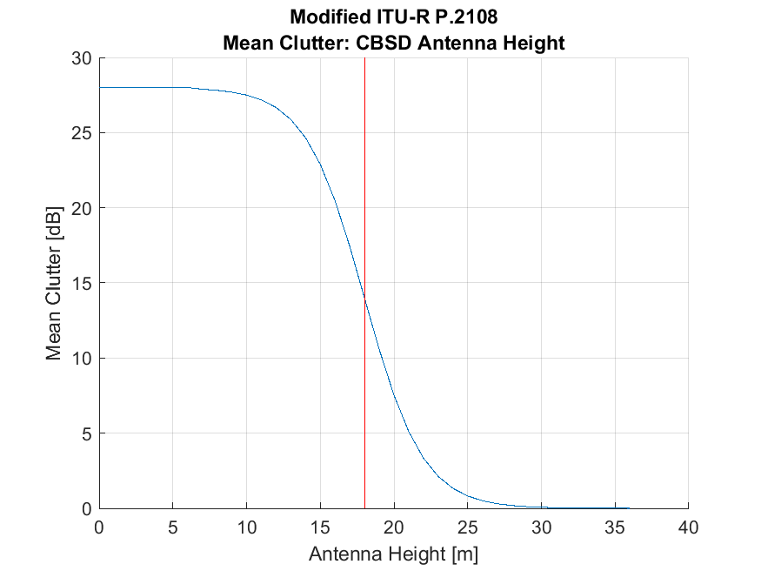
Modified ITU-R P.2108
To account for CBSD antenna height:
CatB CBSD Antenna Height:
6m: 28dB (Full Clutter)
Minimum CatB Height
18m: 14dB
Antenna Height Threshold for Clutter in NTIA 15-517
36m: 0dB
As CBSD height increases, the mean clutter loss decreases.
Variable Placeholders: 6m, 18m, 36m

Slide 6
Example Clutter Model 1.0
Log Distance
Drocella Model 1.0

Slide 7
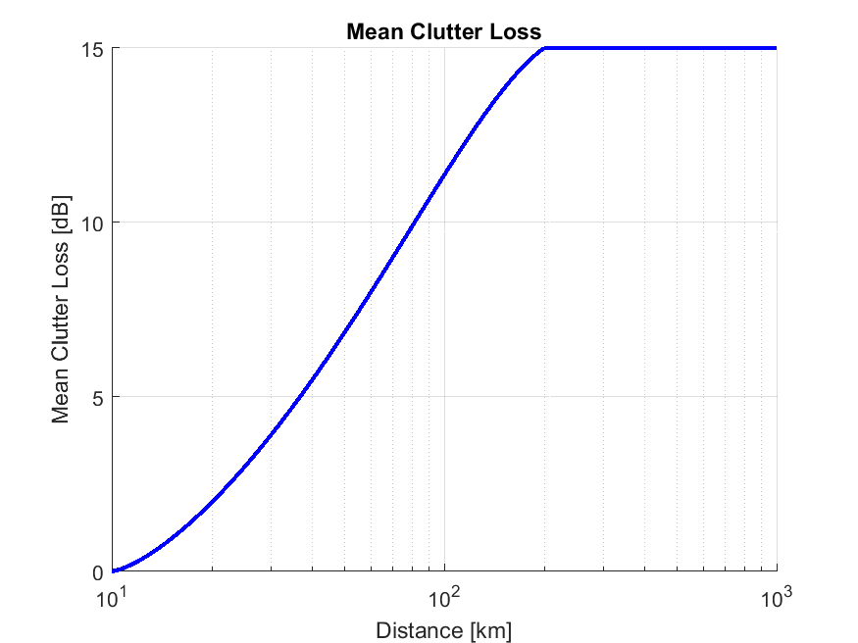
Clutter Loss Model 1.0 (Troposcatter)
NTIA TR 15-517 (3.5GHz Exclusion Zone)
For Rural CBSD Base Stations, an additional clutter factor of 0-15dB, with a uniform distribution, was randomly applied.
Custom Clutter Loss (for these Sims)
For all CatB CBSDs, clutter loss was added, with mean clutter loss based upon a log distance relationship between Transmitter and Receiver
Clutter Loss Input Parameters
10km: 0dB (Distance from coast to DPA inner edge)
200km: 15dB (Rough distance where ITM is troposcatter)

Slide 8
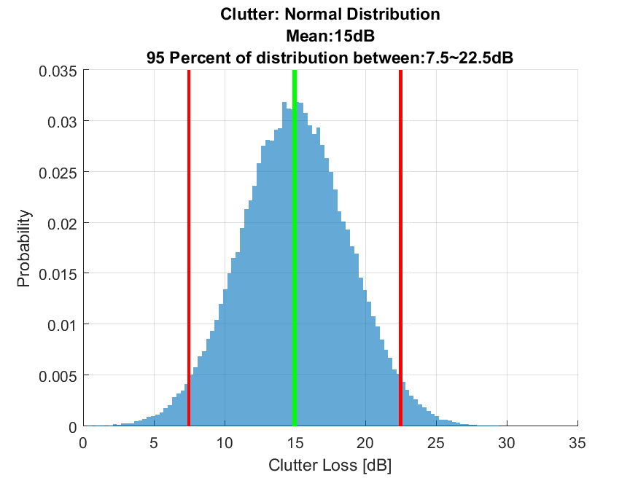
Example: Normal Distribution from Mean Clutter
A Normal Distribution of clutter is randomized based upon the mean clutter loss.
95 Percent of distribution is between 0.5xMean and 1.5xMean
Mean Clutter Loss 15dB → 7.5 to 22.5dB Loss

Slide 9
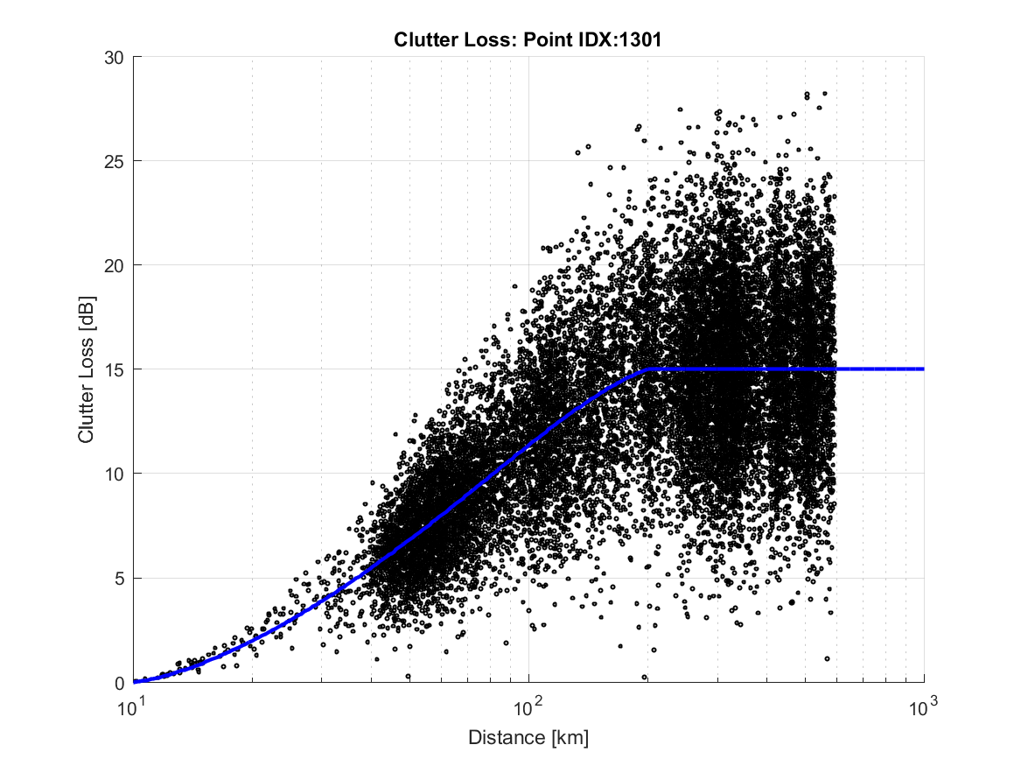
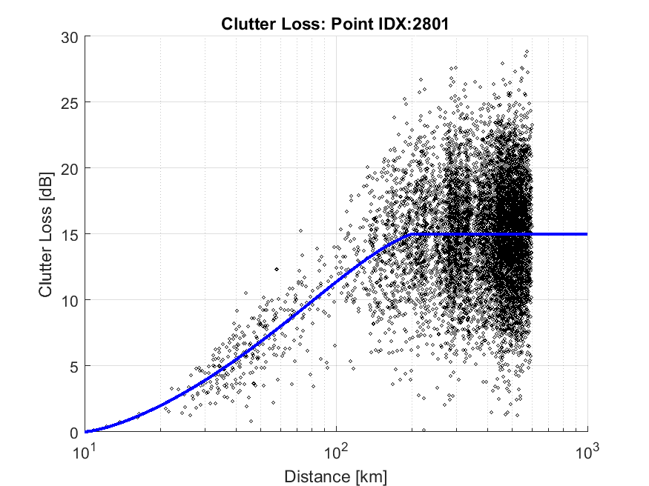
Example Clutter Loss

Slide 10
Example Clutter Model 2.0
Log Distance and Antenna Height
Drocella Model 2.0

Slide 11
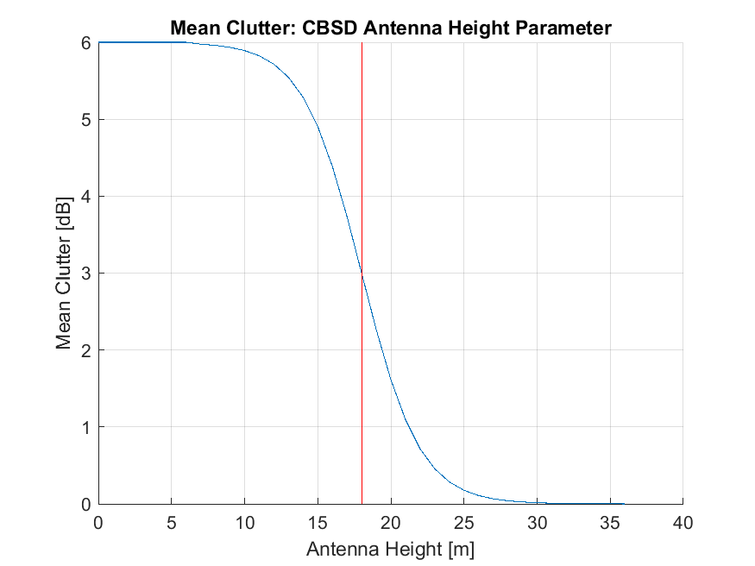
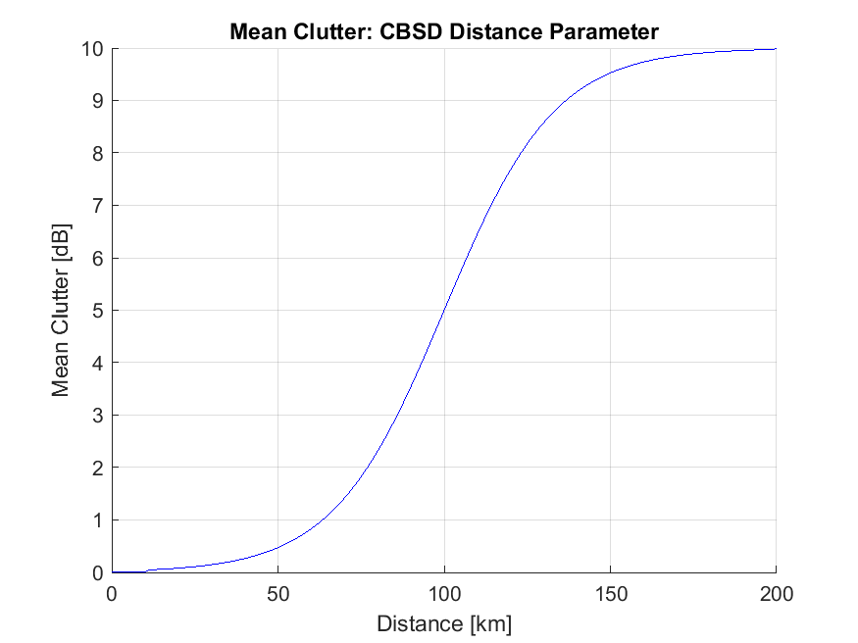
Clutter Model: Log Distance and Antenna Height
NTIA TR 15-517 (3.5GHz Exclusion Zone)
For Rural CBSD Base Stations, an additional clutter factor of 0-15dB, with a uniform distribution, was randomly applied.
Custom Clutter Loss
CatB CBSD Antenna Height:
6m: 6dB
Minimum CatB Antenna Height
18m: 3dB
15-517 Extended Hata Cutoff Height
50m: 0dB
For CatB CBSDs Antenna Heights <50m, additional clutter is added based upon distance
Separation Distance Parameters
10km: 0dB
Distance from coast to DPA inner edge
200km: 10dB
Rough distance where ITM is Troposcatter

Slide 12
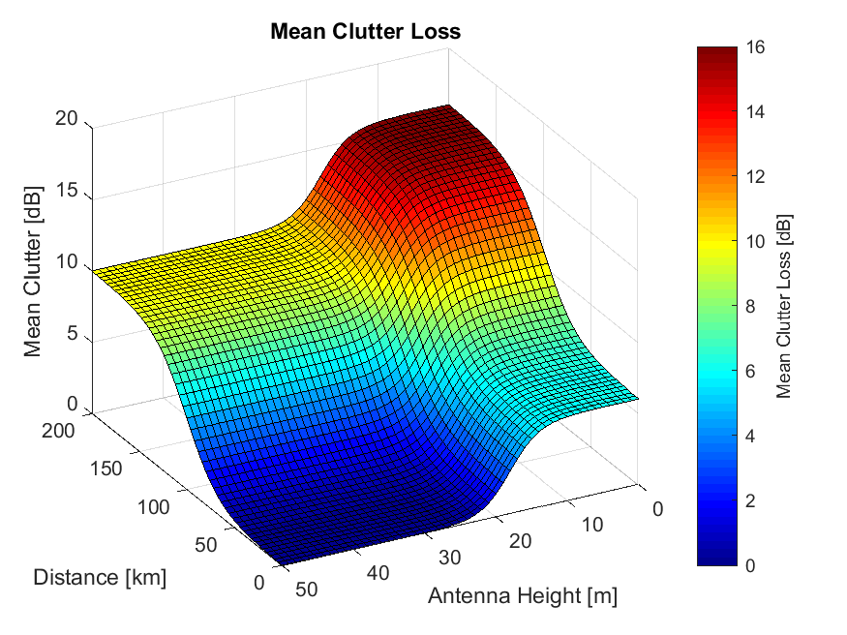
Mean Clutter Loss

Slide 13
Example: Normal Distribution from Mean Clutter
A Normal Distribution of clutter is randomized based upon the mean clutter loss.
95 Percent of distribution is between 0.5xMean and 1.5xMean
Mean Clutter Loss 15dB → 7.5 to 22.5dB Loss

